Slide 1
Multi-thread Request Handling in Java
/demo with Apache Tomcat/

Slide 2
Outline
Single vs multi thread model
How does multi request handling work
Demonstration
QA
Knowledge use

Slide 3


Single vs multi thread model
Single thread
Multi-thread
Single thread processes requests in async manner
Example NodeJS
One thread per request
Example Java Servlet, ASP.NET etc.

Slide 4
How does multi thread request handling work

Slide 5
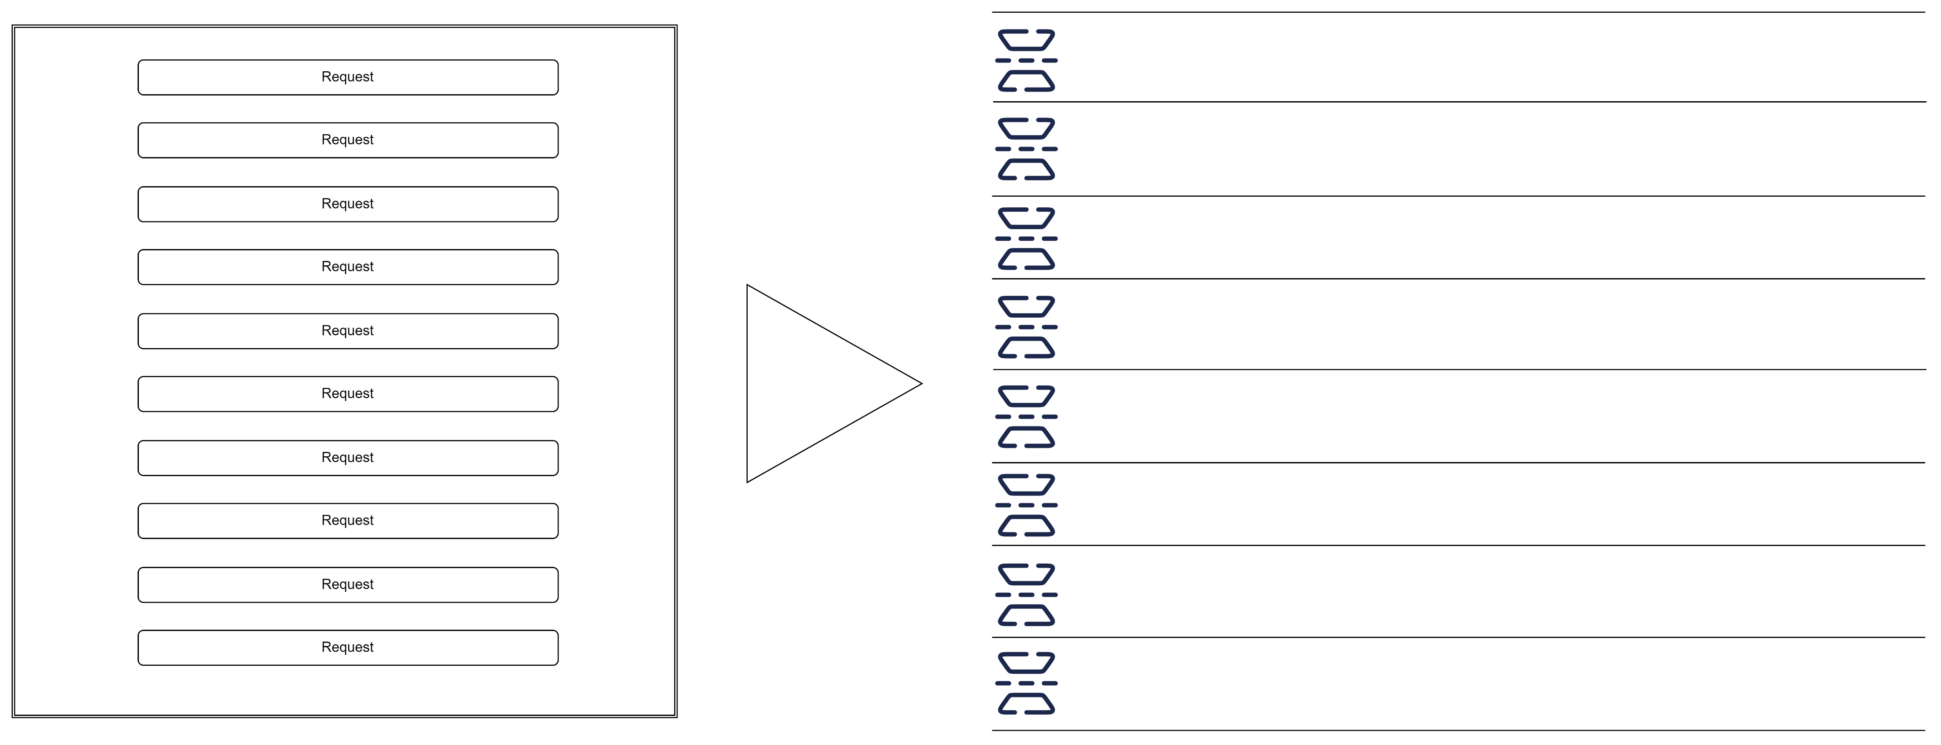

Slide 6

Max connections – 8 * 1024
Max threads – 200
Min/core threads – 10
Keep alive – 60 sec

Slide 7
Demonstration

Slide 8
QA

Slide 9
Knowledge use

Slide 10
To be continued…

